Slide 1
TOMIKO & ADAM’S WEDDING
JULY 26TH, 2025
30 GUESTS
SHANGRI-LA, PARIS
WEDDING MOOD BOARD

Slide 2
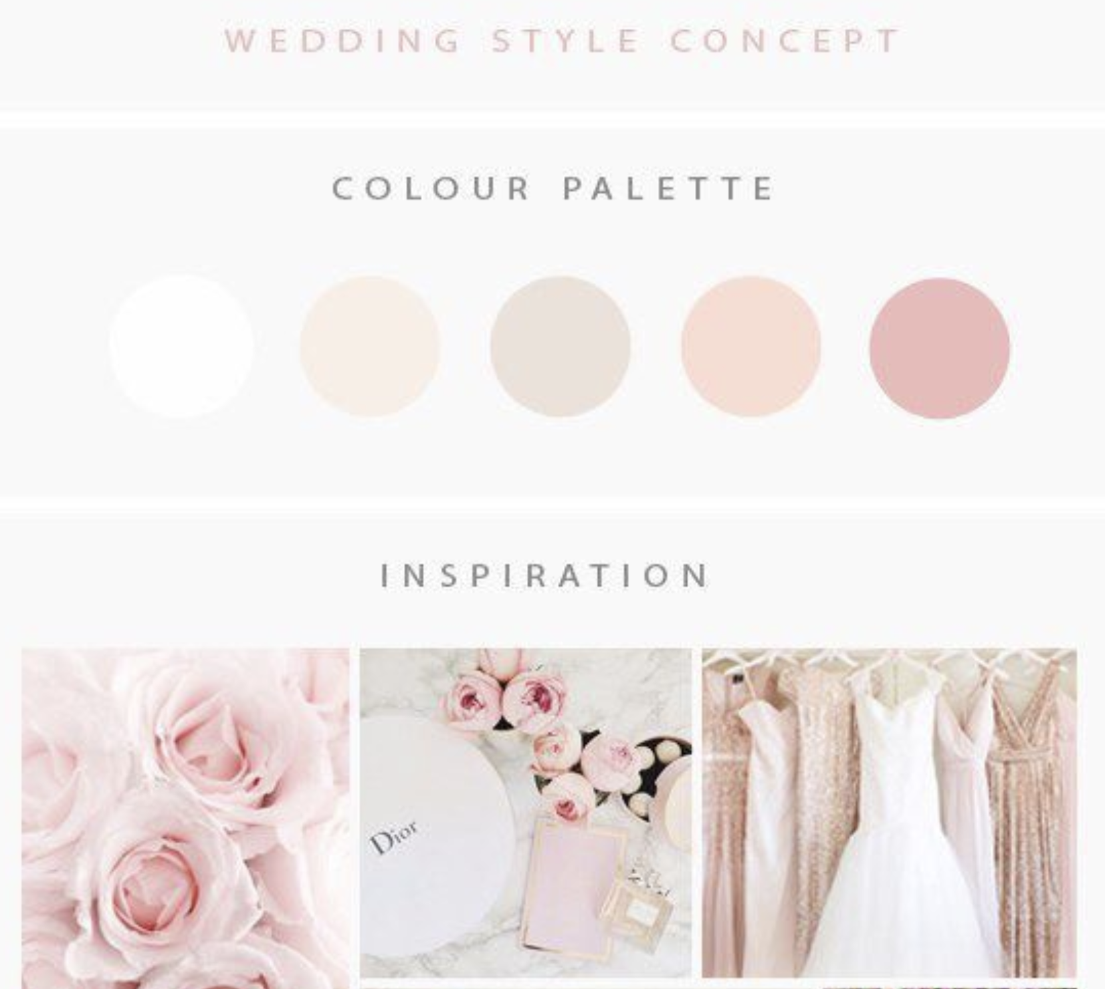
COLOR PALETTE

Slide 3
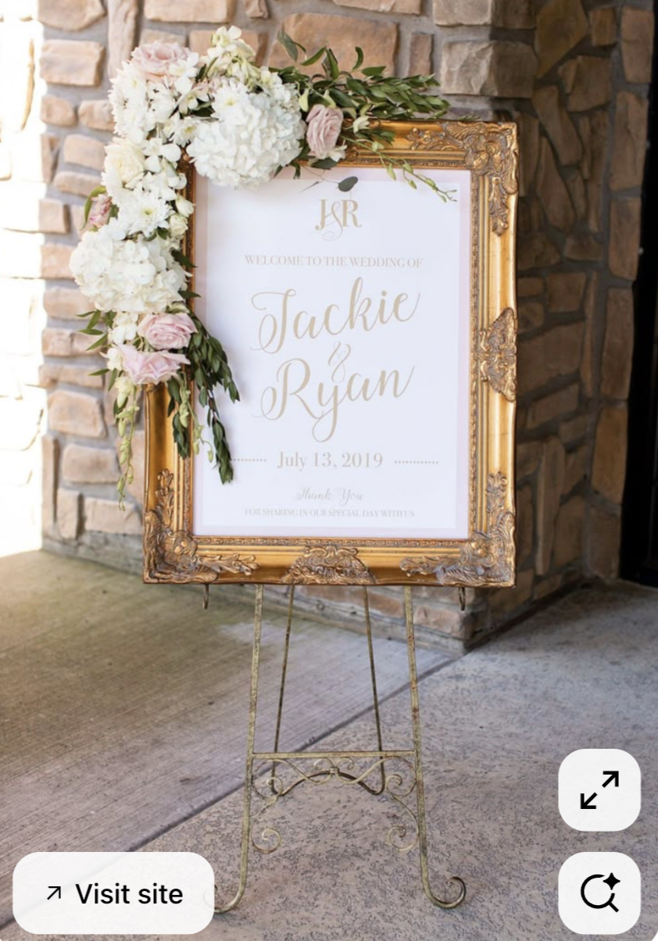
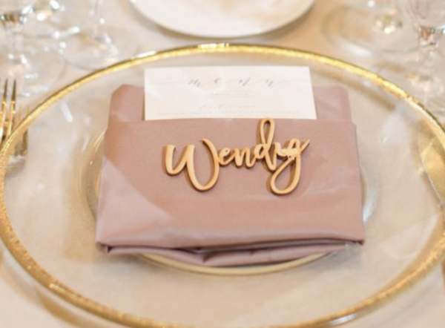
Wedding Sign & Décor + Place cards
For the welcome sign, we’ll use a design identical to the one in the photo, set in an antique gold frame and displayed on a gold easel.
For the place cards, the long rectangular table seats 15 guests per side. Each guest’s name will be placed directly at their seat on the napkin, so they can easily locate their spot.

Slide 4
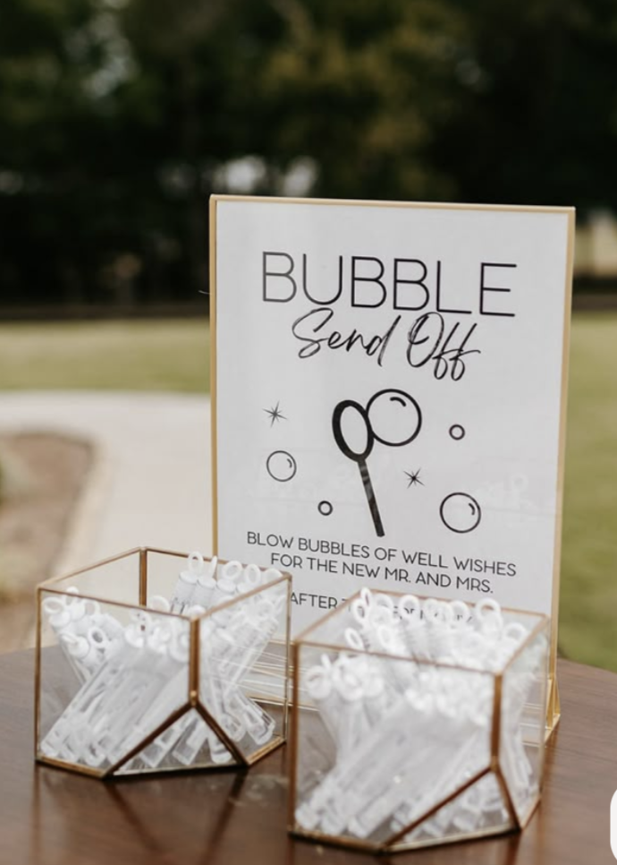
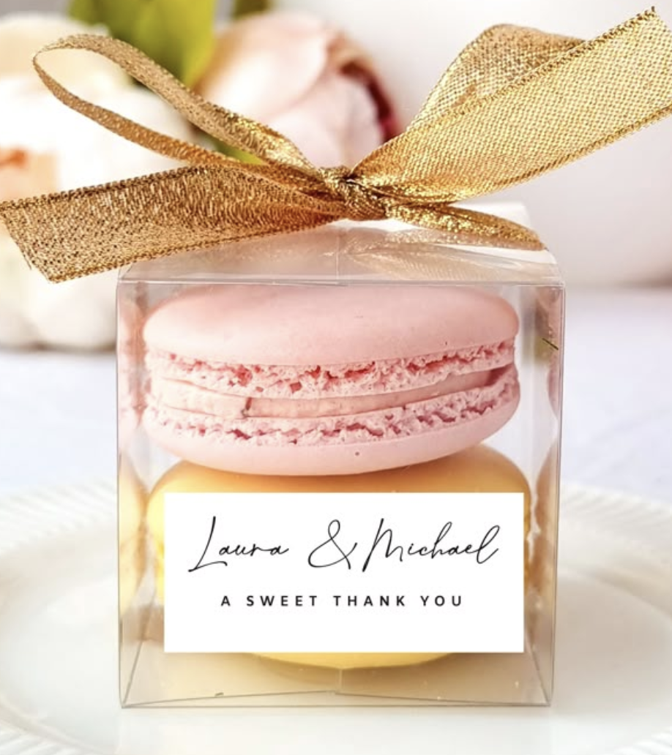
GUEST FAVORS & EXTRA PROPS IDEAS:
Bubble sign + bubble send off for 30 guests
Small customed
macaroons box

Slide 5
NOTES FOR PLANNER AND PAPETERIE
TEAM ONLY (FRENCH):
30 marque place en “Gravure” couleur or comme sur la photo.
1 panneau de Bienvenue + Cadre vintage doré
1 bubble sign + bubble stick + 2 petites boites couleur clear/or
30 boites + macarons personnalisés

